Slide 1
AI Powered Portfolio Builder
Group 28 -
Rishabh Pahwa, Jaskaran Singh Luthra, Sahil Soni, Ishmeet Singh, Aashi Thakkar, Harjot Singh

Slide 2
AGENDA
Introduction
Project Management with Jira
Project Planning
Roles & Responsibilities
Project Progress

Slide 3
INTRODUCTION
We are Team 28, a diverse and enthusiastic group of six students, presenting our progress report for Sprint 1 of our project: AI Powered Portfolio Builder
The Challenge: We're addressing the need to simplify the tedious and manual process of portfolio creation. This task often becomes a hurdle for many individuals trying to effectively showcase their skills and experiences.
Our Solution: We aim to streamline this process through automation and AI. This includes parsing resumes, offering pre-designed templates, allowing easy customization, securely storing user data, and hosting portfolios with unique routes.
Innovation: We're going beyond simple automation. Our solution includes a recommendation system, leveraging AI to provide personalized suggestions for improving each section of a user's portfolio, thus enhancing its impact.
Sprint 1 Focus: This progress report will cover the steps and achievements made during our first sprint: Project Setup, Requirement Gathering, and Design. We'll highlight our progress in setting up project management tools, defining roles and responsibilities, and initiating design work.

Slide 4
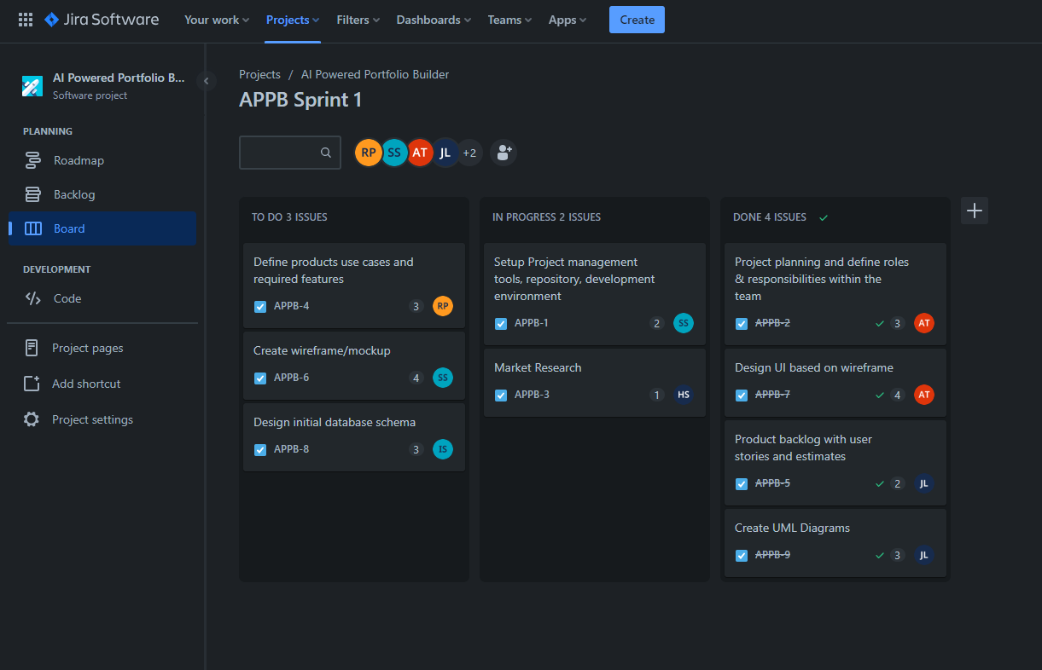
Project Management with Jira
Why Jira?
Jira is a highly popular project management tool developed by Atlassian
It's typically used for issue tracking, bug tracking, and managing agile software development projects
Its flexibility, comprehensive functionality, and collaborative features make it an ideal choice for managing our project

Slide 5
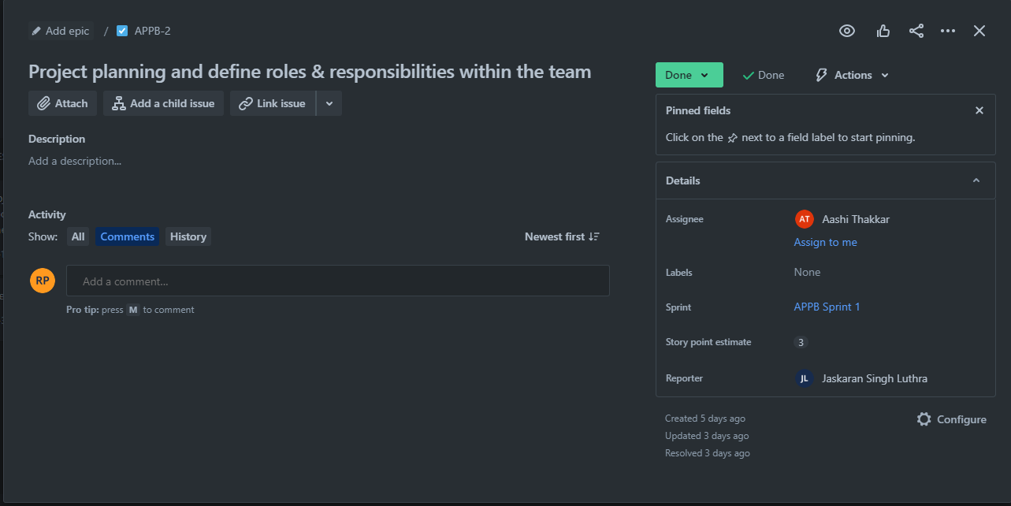
Project Management with Jira
Project Tracking with Jira:
Creating Tasks: We'll use Jira's issue creation feature to define tasks, user stories, and bugs, each with its own priority, due date, and assignee
Assigning Tasks: Each task can be assigned to a specific team member, with notifications ensuring everyone knows their responsibilities
Tracking Tasks and Sprints: Using Scrum board, we can visually track the progress of tasks and sprints, providing clear visibility into the project's status
Dashboards: Jira dashboards will be used for a quick overview of project progress, showing data like the number of open issues, progress on the current sprint, and individual team member workload
Reporting: Built-in Jira reports will give insights on team performance and project progress, such as burndown and velocity charts

Slide 6
Project Planning
Sprint 1
Project Management Tools Setup, Team Roles Definition, Market Research, Product User, Personas, Use Cases, and Features, Product Backlog, Wireframes and Mockups, UI Design, Database Schema Design
Sprint 2
Server Setup, Technology Stack Selection, Front-End Applications Setup, Security Measures Implementation
Sprint 3
Resume Parsing Library/Service Selection, Module for Resume Upload, Parsing, and Data Extraction
Sprint 4
Portfolio Generator Creation, Portfolio Preview Implementation, API for Portfolio Generation, Portfolio Customization Options, Portfolio Export/Download Options
Sprint 5
AI Model Integration for Portfolio Improvement Suggestions, Feedback Mechanisms for AI Model Improvement
Sprint 6
Various Testing (Unit, Integration, Usability), Software Documentation and User Manuals, Application Deployment
Sprint 7
Product Iteration based on Feedback and Analytics, New Feature/Improvement Implementation, Marketing Strategy Refinement

Slide 7
Roles and Responsibilities
JASKARAN SINGH LUTHRA
RISHABH PAHWA
SAHIL SONI
Role: Product Owner
Defines product vision.
Manages and prioritizes the product backlog.
Collaborates with the team to prioritize features.
Role: AI Specialist/Developer
Integrate and implement AI-related functionalities.
Research and select appropriate AI models.
Train and fine-tune AI models.
Role: Scrum Master
Facilitates Scrum events.
Removes impediments.
Ensures adherence to the Scrum process.
Role: AI Specialist/Developer
Integrate and implement AI-related functionalities.
Research and select appropriate AI models.
Train and fine-tune AI models.
Role: Frontend Developer
Implement UI design
Create website's frontend components

Slide 8
Roles and Responsibilities
ISHMEET SINGH
HARJOT SINGH SAGGU
AASHI THAKKAR
Role: Backend Developer
Set up server and backend logic
Integrate with external services
Handle data storage and retrieval
Role: QA Tester
Conduct testing activities
Identify and report any issues or bugs
Role: Backend Developer
Set up server and backend logic
Integrate with external services
Handle data storage and retrieval
Role: QA Tester
Conduct testing activities
Identify and report any issues or bugs
Role: Frontend Developer
Implement UI design
Create website's frontend components
Role: Documentation Specialist
Create comprehensive documentation

Slide 9
Market Study
Competitive Analysis:
Wix.com: With its comprehensive project management suite, Wix.com stands out for its robust collaboration features. It provides users with a wide range of tools and functionalities to effectively plan, track, and execute projects, fostering seamless teamwork and communication among team members.
Site123.com: Site123.com specializes in portfolio optimization and advanced analytics, enabling users to make data-driven decisions when managing their project portfolios. With powerful analytical capabilities, it helps users assess project performance, identify risks, and optimize resource allocation for optimal results.
SquareSpace.com: SquareSpace stands apart with its user-friendly interface, making project management a breeze for both novice and experienced users. Additionally, SquareSpace offers seamless integration with popular project management tools, allowing users to leverage their preferred tools while harnessing the benefits of SquareSpace's intuitive platform. This integration streamlines workflows and enhances productivity for project teams.

Slide 10
Market Study
Based on the competitive analysis and market trends, our project portfolio generator has a unique value proposition in the market. While competitors like Wix.com, Site123.com, and SquareSpace.com offer comprehensive project management suites, our product stands out with its focus on portfolio planning and resource allocation, advanced analytics, and visualization tools. We have the opportunity to leverage growing market trends such as the demand for AI-powered insights, remote collaboration, integration with productivity tools, and sustainability considerations.
To succeed in the market, we need to address challenges related to data security and privacy, market competition, user adoption, and technological advancements. Implementing robust data security measures, continuously enhancing our features, and providing excellent customer support will help us differentiate ourselves from competitors. Additionally, we must focus on effective marketing and distribution strategies, including pricing, targeted messaging, and identifying the most suitable marketing channels and distribution partners

Slide 11
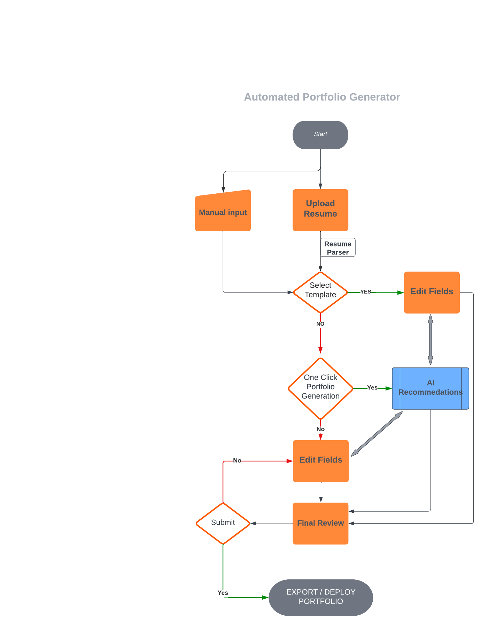
Progress Report - Flow Diagram

Slide 12
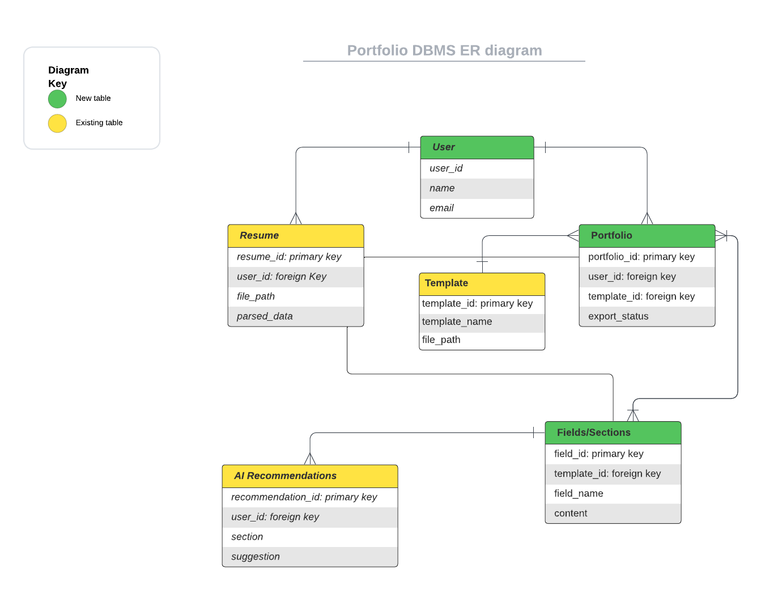
Progress Report – ER Diagram

Slide 13
Screen Shots

Slide 14
THANK YOU

